Slide 1
Bank loan analysis
Vimal chandran
Kavya churi
Himanshu
Akshay
Shailesh singh
Priyanka
Talish raza

Slide 2
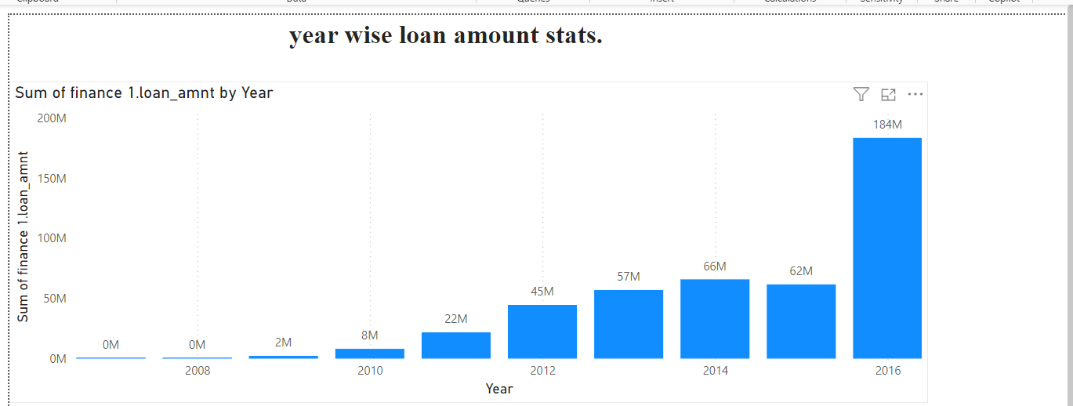
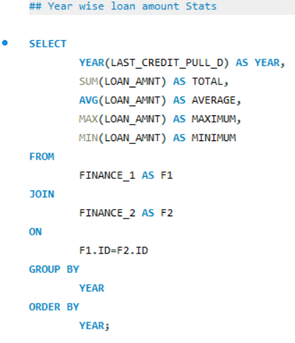
YEAR WISE LOAN AMOUNT AND STATS
Insights:
LOAN AMOUNT :
Representing the year wise loan amount by the year 2007 to 2016.
Overall the year wise loan amount ,year 2016 has the highest loan amount and year 2008 has the lowest loan amount.
STATS : Maximum, Minimum, Sum.
Maximum : it shows max loan amount throughout years.
Minimum : it shows min loan amount throughout years.
Sum : represents the total loan amount

Slide 3
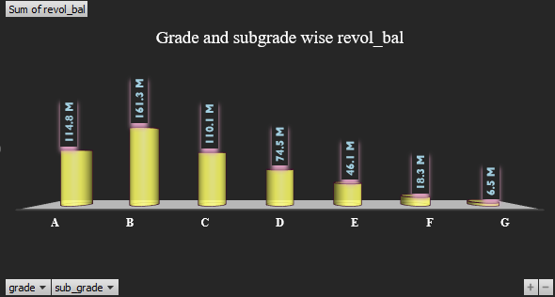
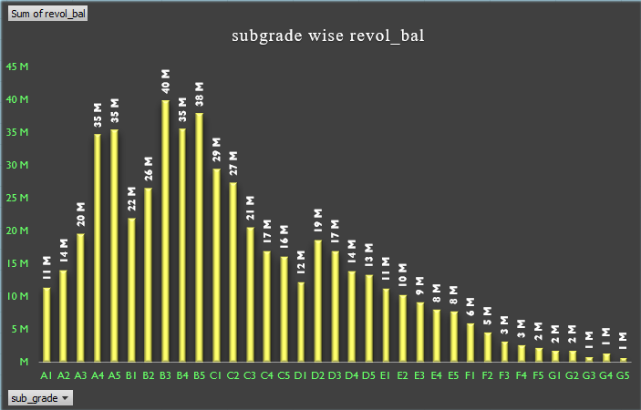
Grade and sub grade wise revolving balance
In KPI 2 we need to find out the relation between Grade, sub-grade and revolving balance. The data shows us the total revolving balance contributed from each sub-grade and grade.
Grade: If we look at grade wise revolving balance. grade B have highest revolving balance with 161.3 M and grade G have lowest revolving balance with 6.5 M.
Sub Grade: When we look in detail by sub grade wise, we can understand even though grade B is highest and G is lowest, there are few sub grades in B which have less revolving balance compared to other sub grades.

Slide 4
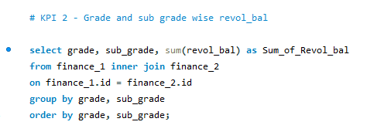
Insights:
Revolving balance:
Grade and subgrade wise revolving balance clearly indicates that a consumer with high revolving balance is relying more on credit amount.
Less revolving balance means either consumer is less relying on credit amount or they keep using the credit amount and repaying over and over as a result they can improve credit score also.
Through this data we can see consumers who are categorised under various grades and sub grades, who uses too much of the credit amount that can hurt they credit score.
To get the most out of revolving credit, a consumer needs to make minimum payment on time. They at least need to try and make more than the minimum payment or pay off they balances in full each month to avoid interest charges.

Slide 5
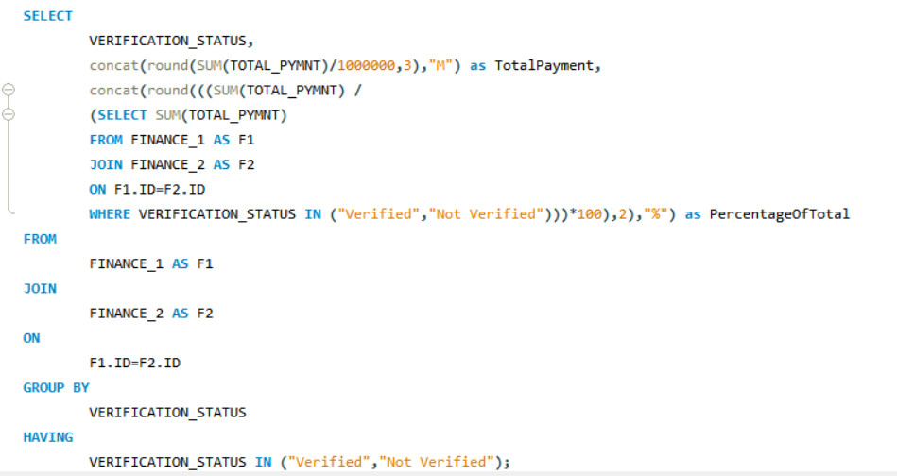
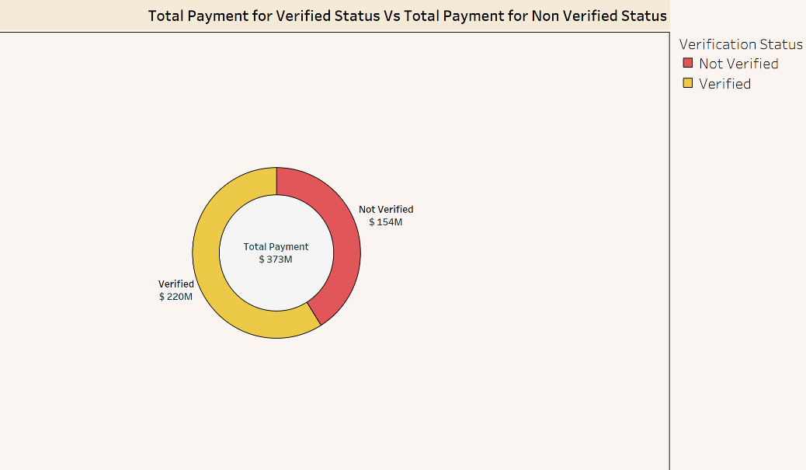
Total Payment for Verified Status Vs Total Payment for Non Verified Status
Data Preparation:
Load your loan data into Tableau.
Ensure that the dataset includes a column indicating the verification status (e.g., “Verified” or “Non-Verified”) and the payment amount

Slide 6
Create a Calculated Field:
In Tableau, create a calculated field that sums the payment amounts based on the verification status.
For example, you can create a calculated field called “Total Payment” with the following formula:
IF [Verification Status] = "Verified" THEN [Payment Amount] ELSE 0 END
This formula calculates the total payment for verified customers.
Visualize the Comparison:
Drag the calculated field for total payment onto the Rows or Columns shelf.
Use the verification status as a dimension (e.g., place it on the Colour shelf).
You’ll see a side-by-side comparison of total payments for verified and non-verified customers.
Additional Insights:
Consider creating other visualizations, such as bar charts or pie charts, to further explore the data.
You can also analyse payment trends over time or across different loan types.

Slide 7
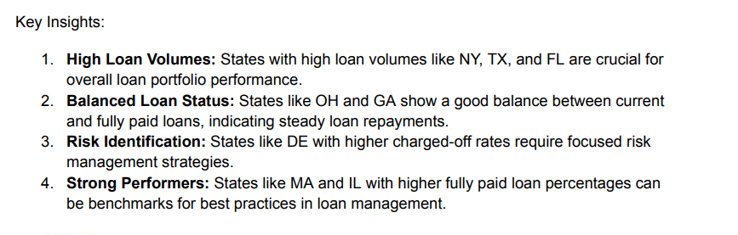
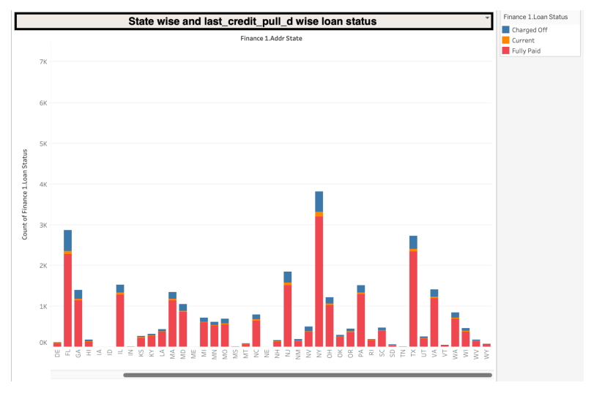
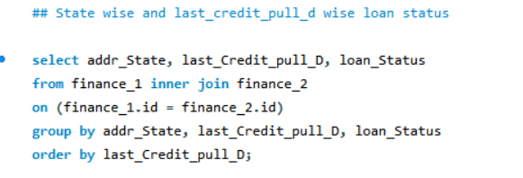
State-wise and Last Credit Pull Date-wise Loan Status

Slide 8
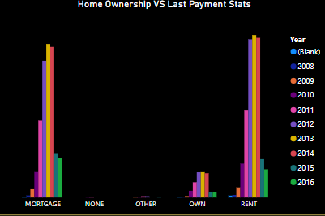
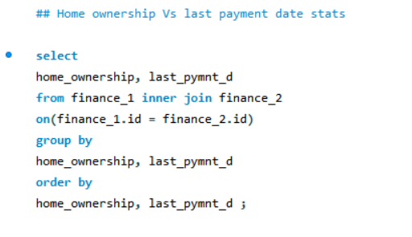
Home ownership Vs last payment date stats
Trends Over Time: Each category shows variations over the years. For instance, the 'MORTGAGE' category peaks around 2013 before slightly declining, while the 'RENT' category shows a steady increase, peaking in 2016.
Minimal Data for 'NONE' and 'OTHER': The categories 'NONE' and 'OTHER' have significantly lower counts compared to 'MORTGAGE' and 'RENT'. This indicates that very few home owners are associated with these types of home ownership.
Stability in 'OWN' Category: The 'OWN' category shows relatively stable counts across the years, with a slight increase towards 2016.
Dominance of Mortgage and Rent: In all nine year the number of home owner are highest in these categories compared to others

Slide 9
Excel dashboard

Slide 10
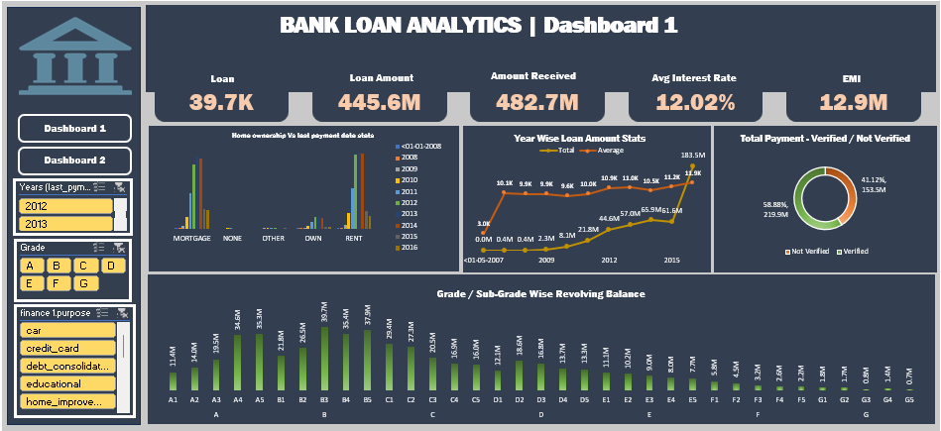

Slide 11
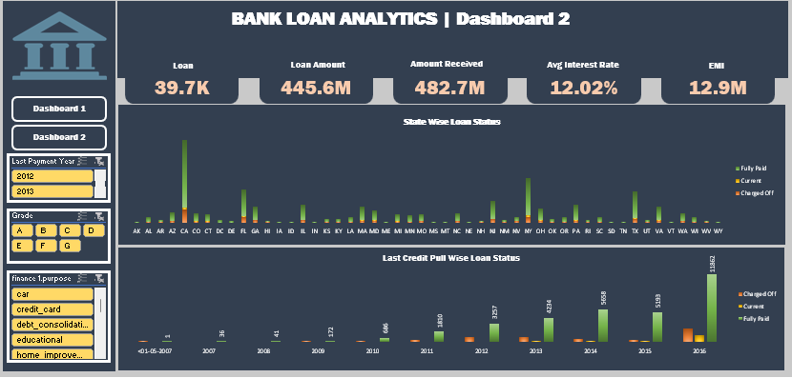

Slide 12
Power bi dashboard

Slide 13
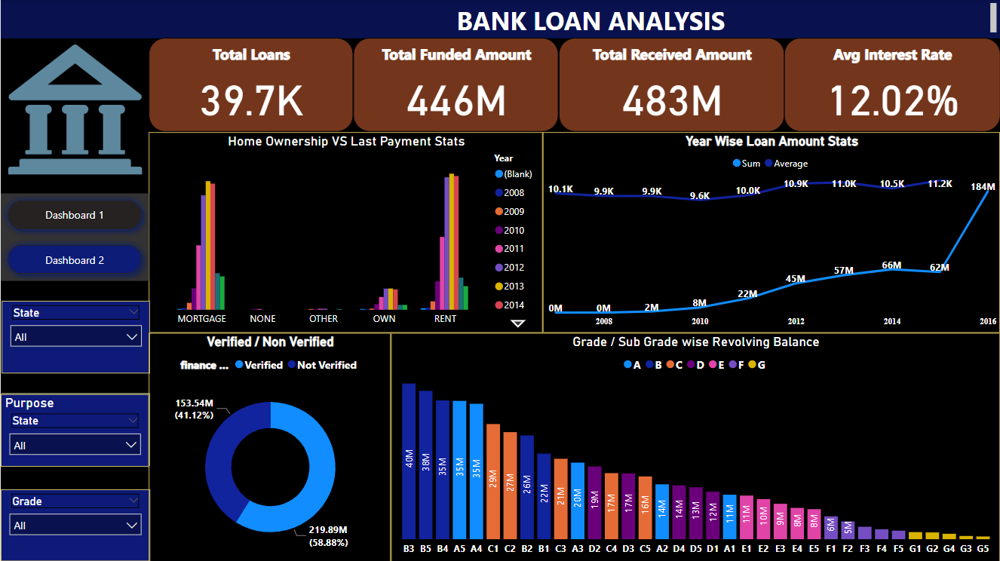

Slide 14
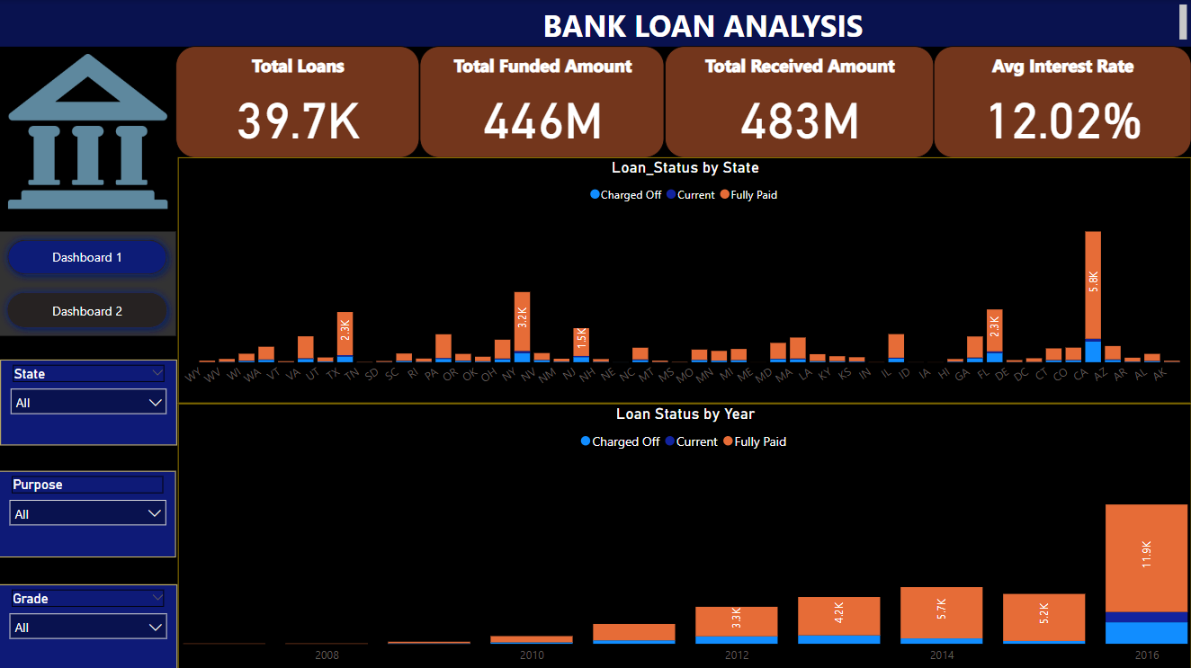

Slide 15
Tableau dashboard

Slide 16
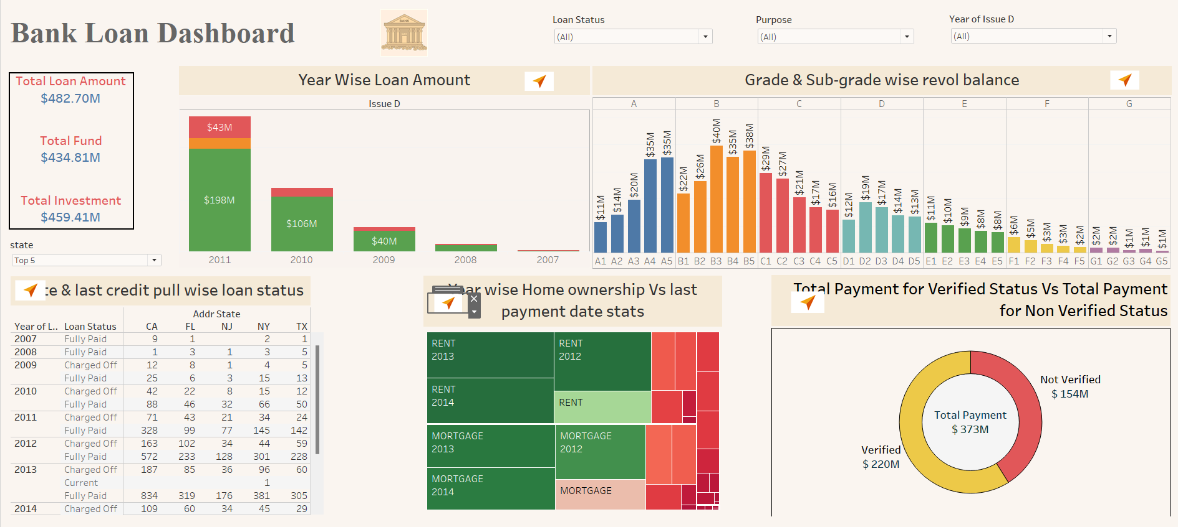

Slide 17
THANK YOU

